Slide 1
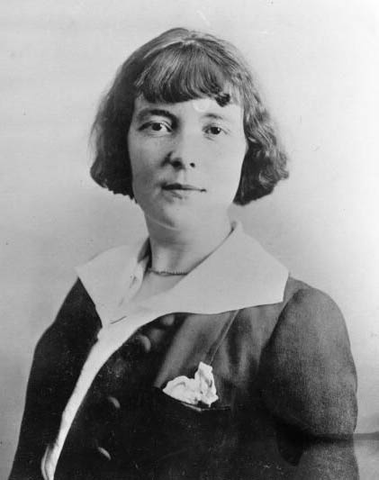
THE GARDEN PARTY

Slide 2
Author Biography
Katherine Mansfield was born to a wealthy family in Wellington, New Zealand, on October 14, 1888. She was educated in London, deciding early on that she wanted to be a writer. She studied music, wrote for the school newspaper.
However, Mansfield was rebellious, adventurous, and more enamoured of the artistic community than of polite society.
Mansfield began publishing stories in Australian magazines in 1907, and shortly thereafter returned to London.

Slide 3
Synopsis
"The Garden Party", written by Katherine Mansfield, is the story of an upper-class British family who is throwing a party for friends. It is a warm, summer day while the family makes preparations, by cooking food and setting up a location for the marquee and band. While preparing, the family hears about a tragic accident which occurred in the poor part of the neighborhood, at the bottom of the hill. A young man was thrown from a horse, and killed, leaving behind his wife and five children. The one daughter, Laura, is upset about the news and wants to cancel the entire party. Her family thinks she is overreacting, and doesn't believe the death should affect them because their house is at the top of the hill and is separated from the lower-class families.

Slide 4
Characters
Laura Sheridan: Pretty teenager who undergoes a conflict on the day of a garden party. Laurie Sheridan: Laura's brother. Laurie could be a nickname for Laurence. Meg, Jose: Sisters of Laura and Laurie. Mrs. Sheridan: Class-conscious mother of the Sheridan children. Mr. Sheridan: Husband of Mrs. Sheridan and father of the Sheridan children. Mr. Scott: Cart driver killed in an accident. His family lives in a settlement of commoners down the road from the Sheridan home. Em: Grieving widow of the cart driver. Woman in Black: Sister of Em. Kitty Maintland: Friend of Laura. Florist: Person who delivers lilies to the Sheridan home before the garden party. Man From Godber's: Man from a bakery who delivers pastries to the Sheridan home. While making the delivery, he reports the death of Mr. Scott and describes how he was killed. Cook: The cook in the Sheridan home. Sadie, Hans: Servants. Four Workmen: Men who set up the marquee for the garden party. Gardener: Worker who arose at dawn to cut the grass on the Sheridan estate.

Slide 5
Themes
Class consciousness. Laura feels a certain sense of kinship with the workers and again with the Scotts. Her mother thinks it would embarrass them to receive flowers from the poor. An omniscient narrator also explains that as children Laura, Jose, Meg and Laurie were not allowed to go near the poor's dwellings, which spoil their vista.
Illusion versus reality. Laura is stuck in a world of high class housing, food, family and garden parties. She then discovers her neighbour from a lower class has died and she clicks back to reality upon discovering death.
Sensitivity and insensitivity; Death and Life. The writer masterfully handles the theme of death and life in the short story. The realization of Laura that life is simply marvellous shows death of human being in a positive light. Death and life co-exist together and death seems to Laura merely a sound sleep far away from troubles in human life.

Slide 6
Setting
The time is early summer in a year in the first decade of the 20th Century. The story unfolds at the estate of a well-to-do upper-class family on Tinakori Road in Wellington, New Zealand (which was the real-life locale where author Katherine Mansfield lived beginning in 1898), at the nearby home of a poor lower-class family, and on the road between the two dwellings. Mansfield, grew up in Wellington, attended school there, furthered her education in England in 1903, returned to Wellington in 1906, and returned to England while still under age twenty to pursue a writing career. Her father, a prosperous banker, supported her move with a generous financial allotment.

Slide 7
Literary devices
metaphor – only the blue was veiled with a haze of light gold.
Personification – they were like trees you imagined growing on a desert island, proud, solitary.. Etc.
Simile – she felt just like a work-girl.
Onomatopoeia – “tuk-tuk-tuk,” clucked cook like an agitated hen.

Slide 8
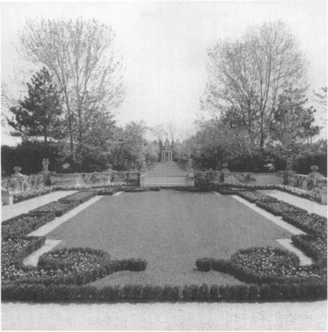
Formal garden design with rectangular middle with small shrub borders and grass in the centre.

